Slide 1


Slide 2
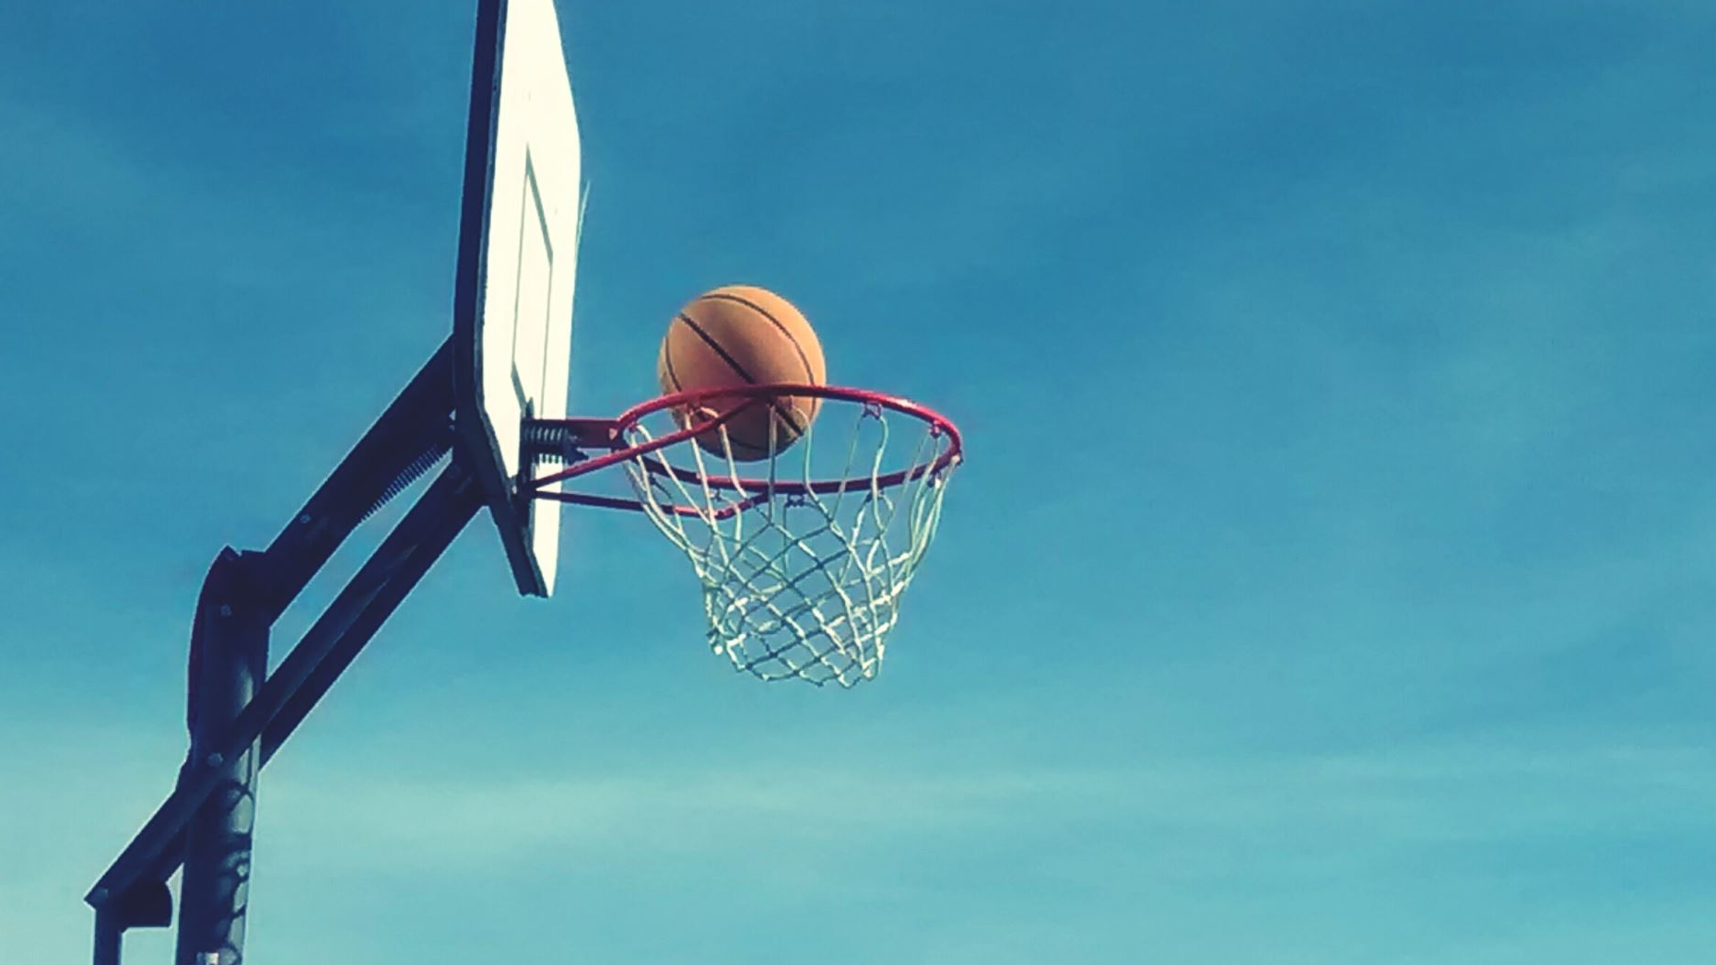
WNBA : A saga

Slide 3

Worldwide

Slide 4

Love
of
Game

Slide 5

DATASET

Slide 6
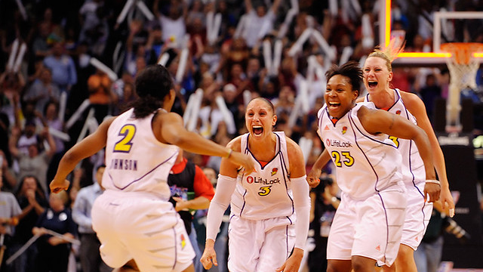
142
Players

Slide 7
10
Countries

Slide 8
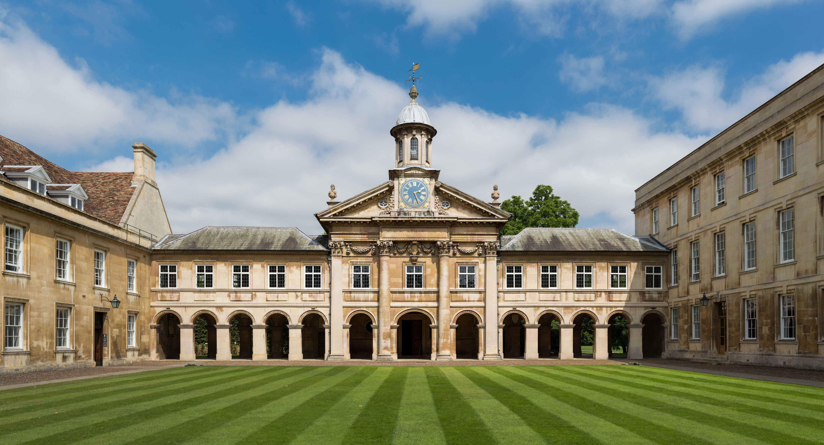
65
Colleges

Slide 9
Age
36
21

Slide 10
Experience
15
1

Slide 11
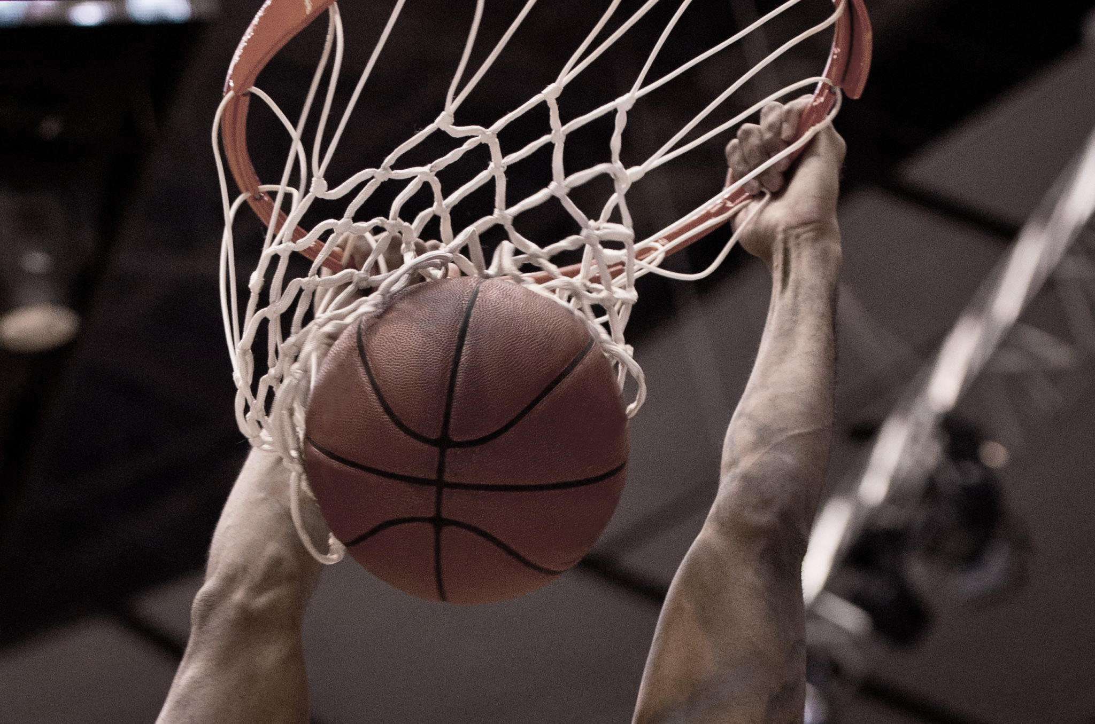
SO WHAT?

Slide 12
3469
Games
71000
Minutes
28850
Total Points

Slide 13
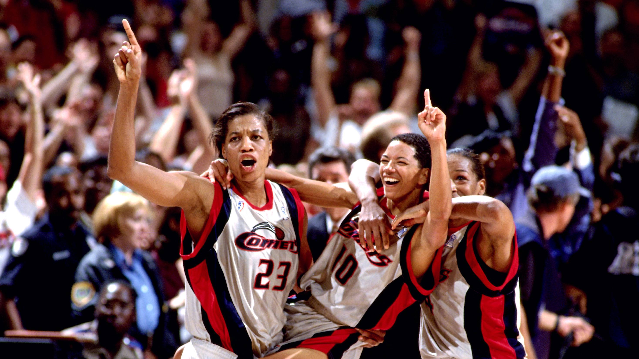


6321
ASSISTS
This Photo by Unknown Author is licensed under CC BY-NC-ND
Notes:
average number of assists for WNBA players higher than the average for WNBA and NBA players together which is 52 denoting friendship and team spirit for the game.

Slide 14
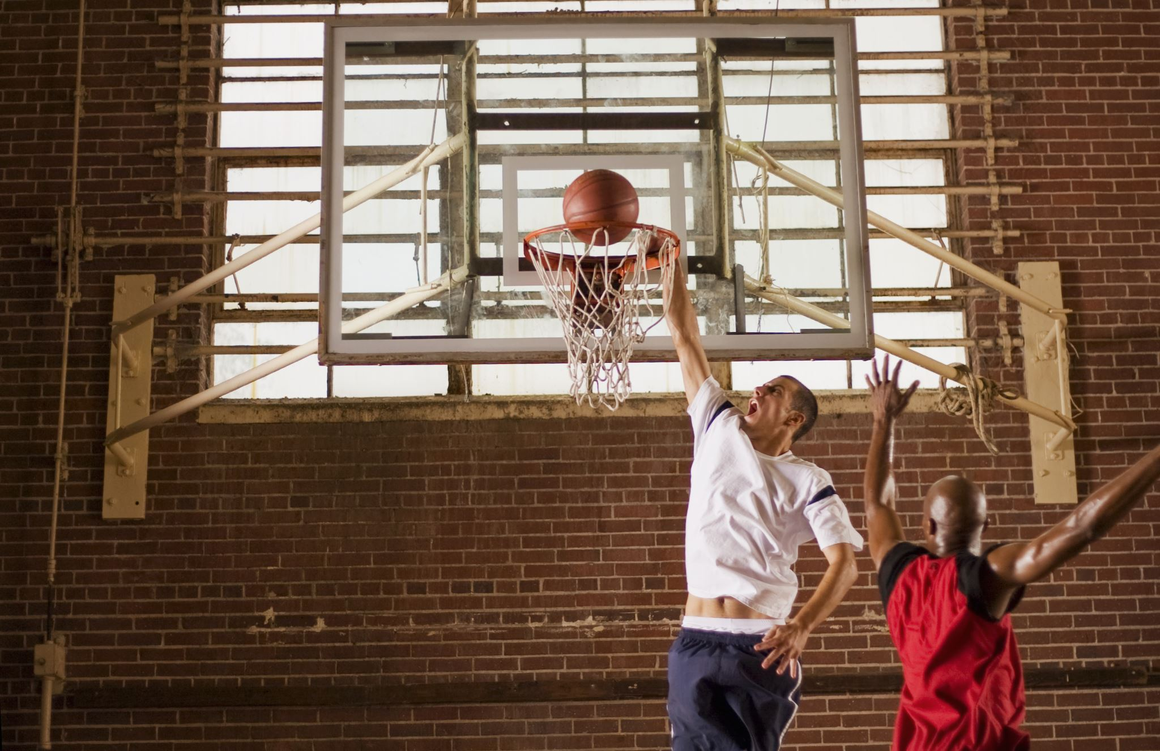
1389
BLOCKS
2517
STEALS
11879
REBOUNDS
Notes:
AST:6321
REB: 11879
BLK: 1389
STL: 2517
OREB:3133
DREB: 8746

Slide 15
35%
3Points
80%
Free Throw
44%
Field Goals
Notes:
Same as the 3p points made by NBA in 2014-15

Slide 16
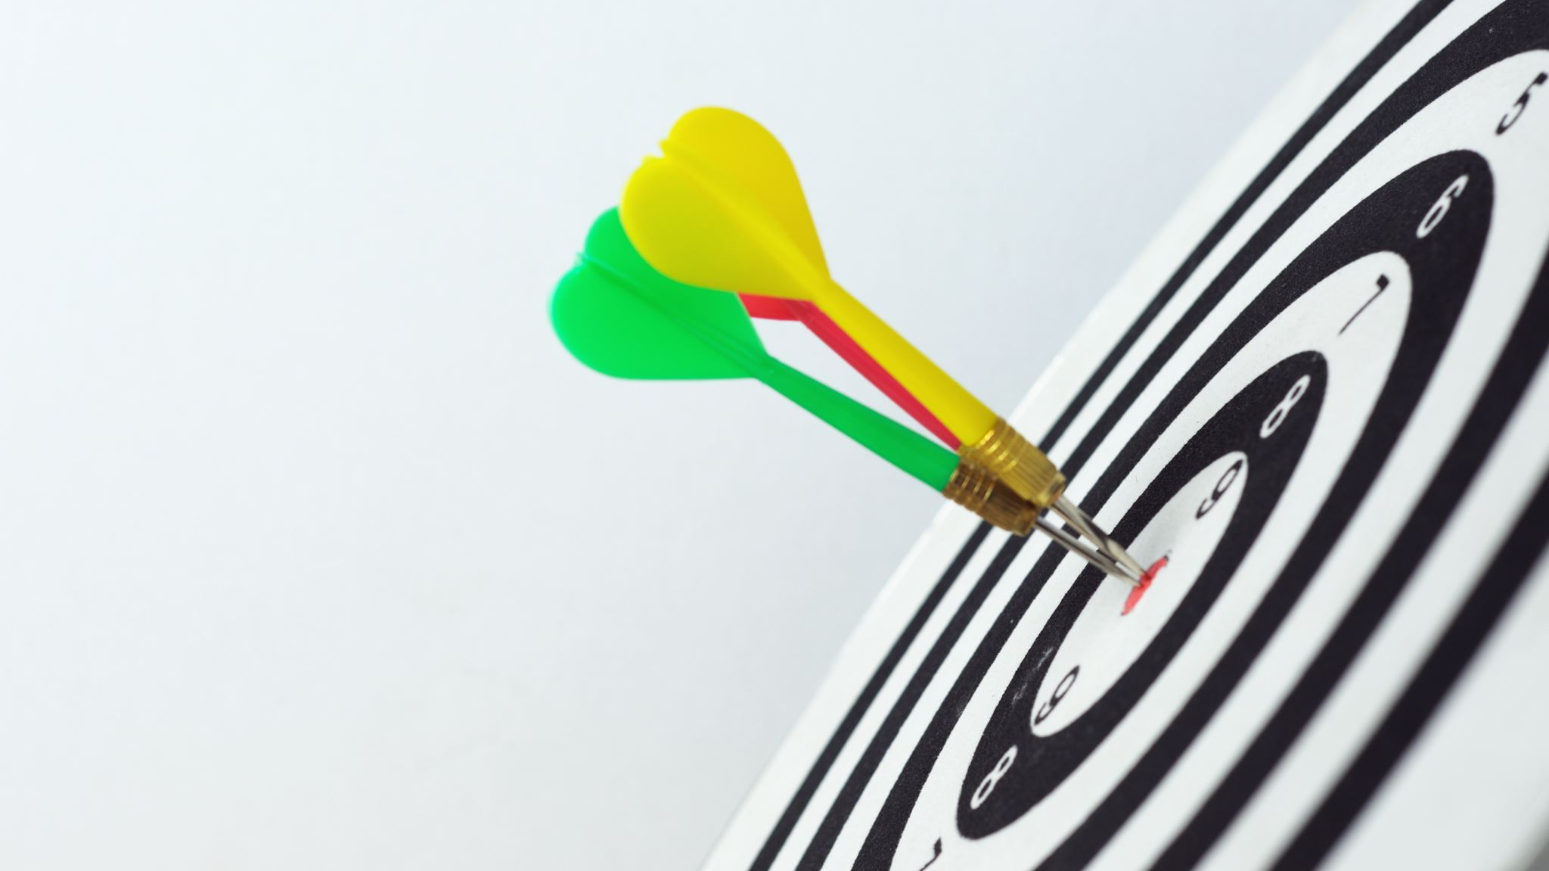
IMPRESSIVE
Notes:
So do you want to join the dataset.

Slide 17
COME CLOSER

Slide 18
LOOK CLOSER

Slide 19

AVG AGE WNBA
27 -28
AVG AGE US WOMEN
39.5
Notes:
https://en.wikipedia.org/wiki/Demographics_of_the_United_States#:~:text=The%20median%20age%20of%20the,median%20age%20is%2039.5%20years.

Slide 20


s
THERE GOES YOUR DREAM TO BE IN WNBA IF YOU DO NOT MEET THE AGE !!!!!!

Slide 21
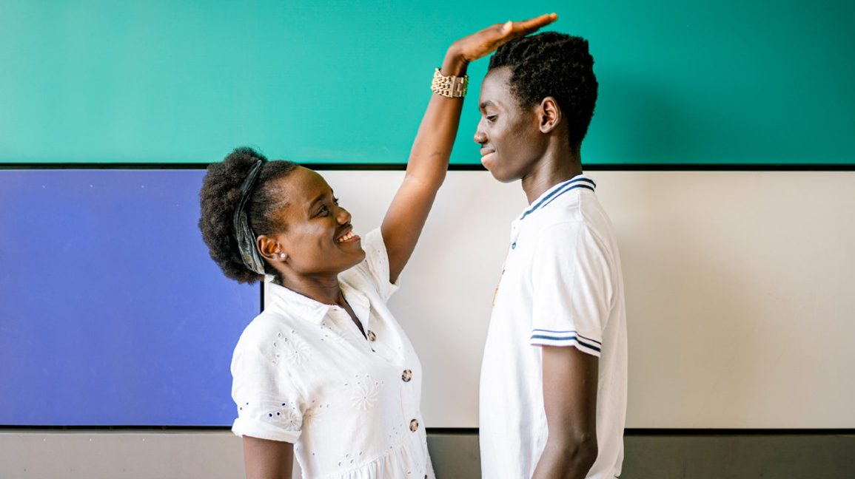
AVG HEIGHT WNBA
183 -186
AVG HEIGHT US WOMEN
161.5

Slide 22
THERE GOES YOUR DREAM TO BE IN WNBA IF YOU ARE STUNTED !!!!!!

Slide 23
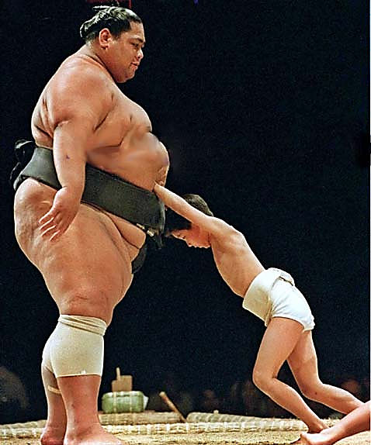
AVG WEIGHT WNBA
77 -80
AVG WEIGHT US WOMEN
76.4

Slide 24
THERE GOES YOUR DREAM TO BE IN WNBA IF YOU ARE NOT FIT !!!!!!
Notes:
BUT DO NOT GET DEPRESSED

Slide 25

OUTLIERS/ SWEET EXCEPTIONS

Slide 26
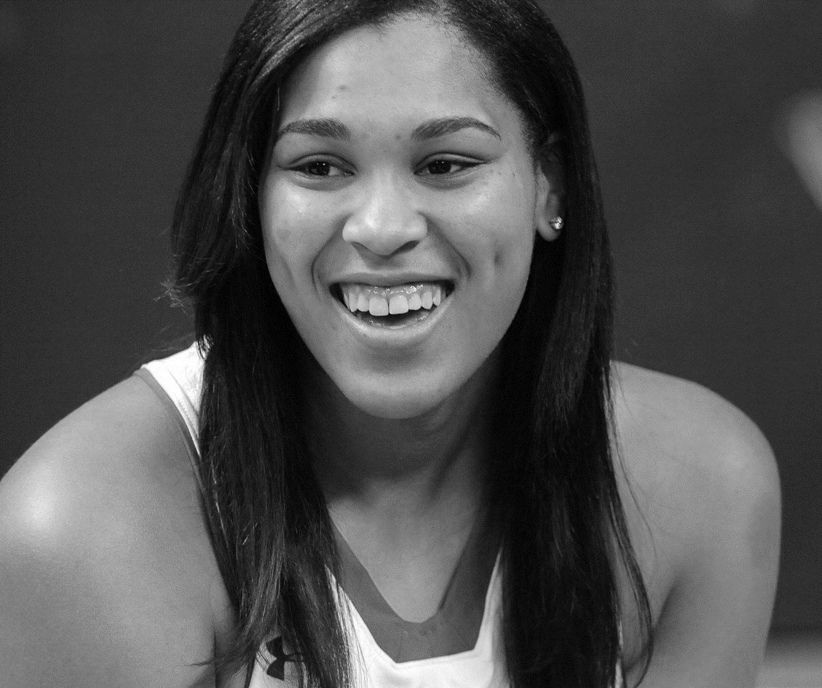
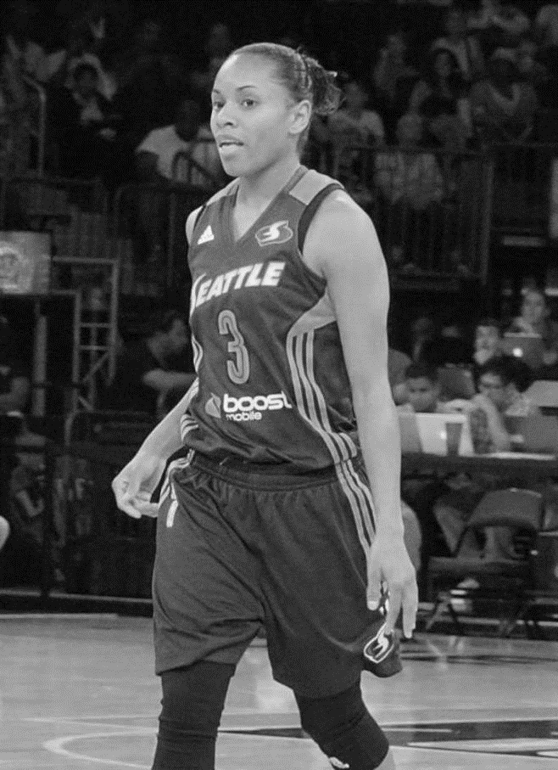
Brionna Jones
Angel Robinson
YOUNGEST PLAYER , AGE: 21

Slide 27
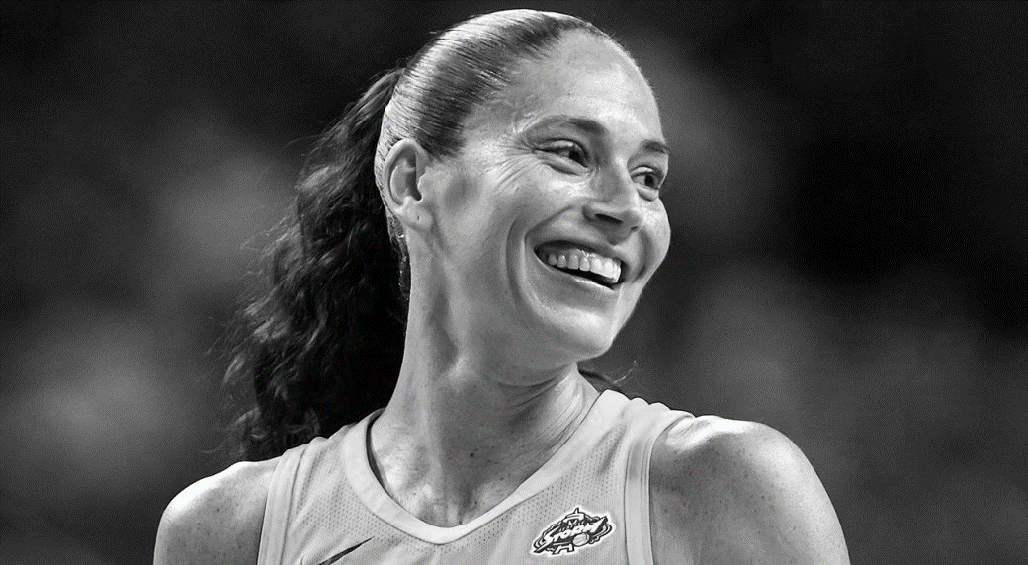
Sue Bird
OVERCOME INJURY | EXPERIENCED PLAYER | AGE : 36
Notes:
Overcoming Injury: Sue Bird tore the ACL in her left knee as a freshman at the University of Connecticut, but went on to capture a pair of NCAA titles (2000, 2002), and was three times named the Nancy Lieberman-Cline Point Guard of the Year.

Slide 28
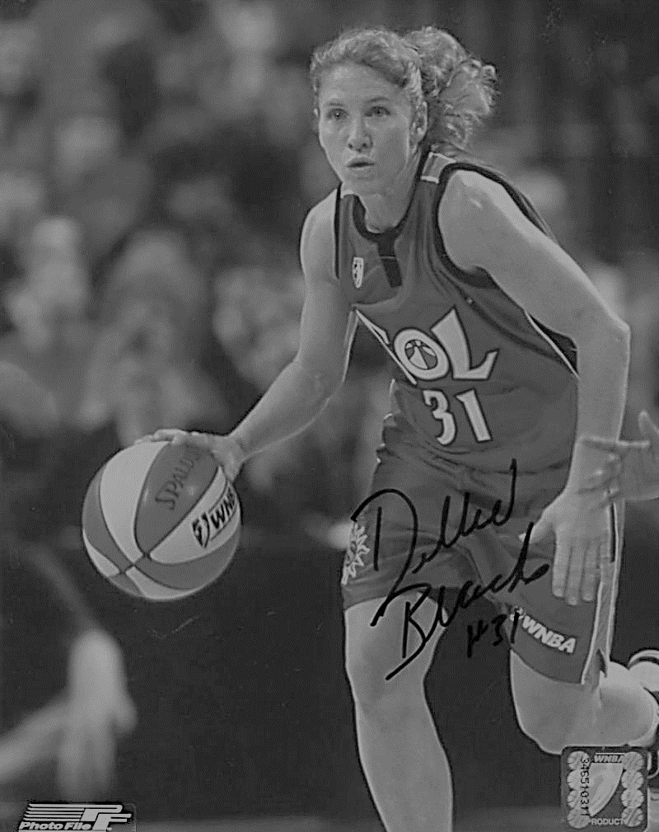
Debbie Black
SHORTEST PLAYER , HEIGHT: 158cm
Notes:
I think I still have hope with my height..

Slide 29
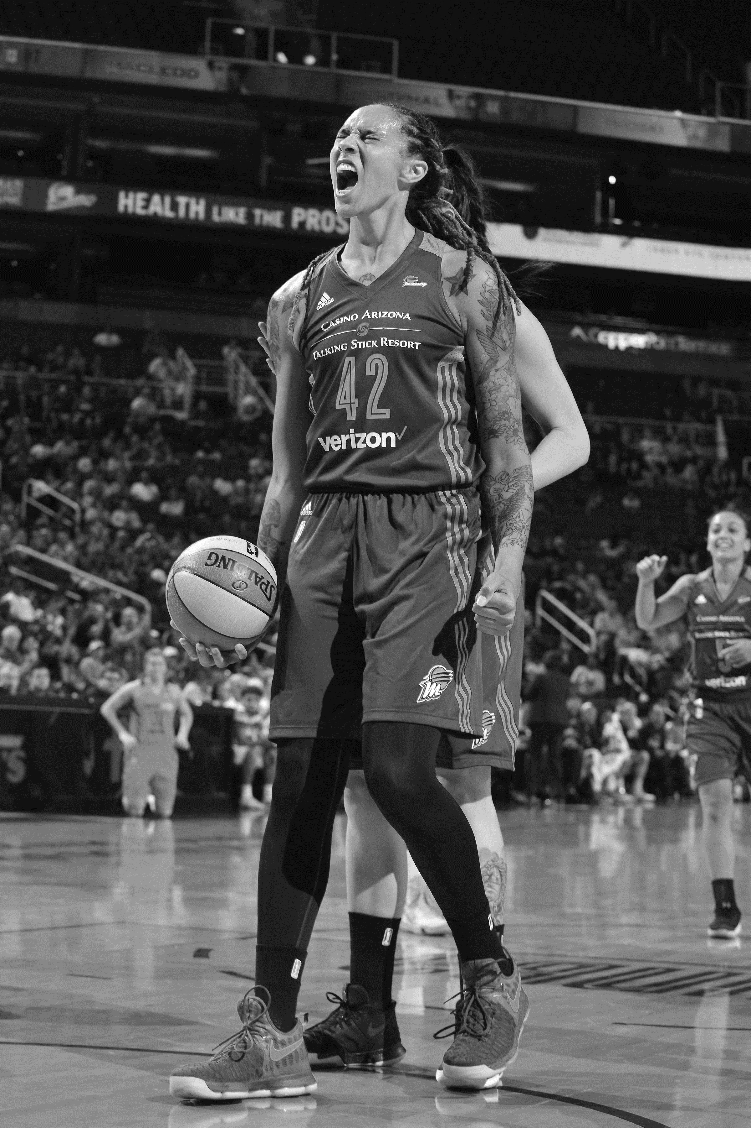
Brittney Griner
TALLEST PLAYER , HEIGHT: 206 cm
Notes:
I think I still have hope with my height..

Slide 30
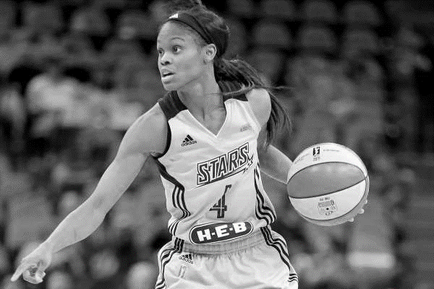
Moriah Jefferson
LOWEST WEIGHT , WEIGHT: 55 kgs
Notes:
I think I still have hope with my height..

Slide 31
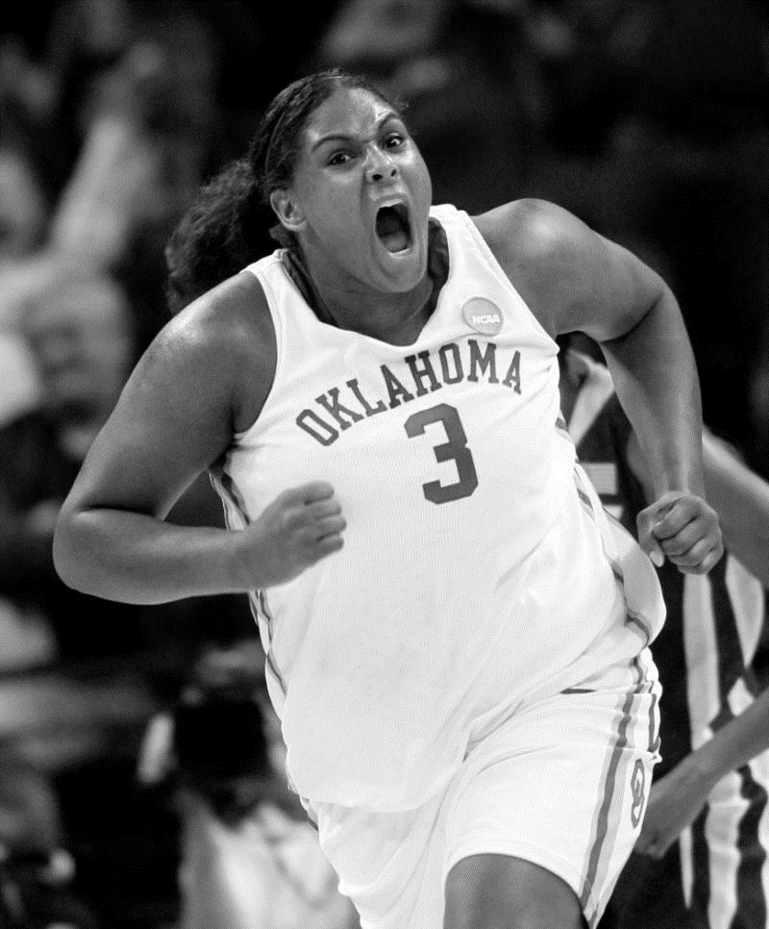
Courtney Paris
OVERWEIGHT , WEIGHT: 113 kgs
Notes:
I think I still have hope with my height..

Slide 32
OUTLIERS/ SWEET EXCEPTIONS (OUTSIDE DATASET)

Slide 33
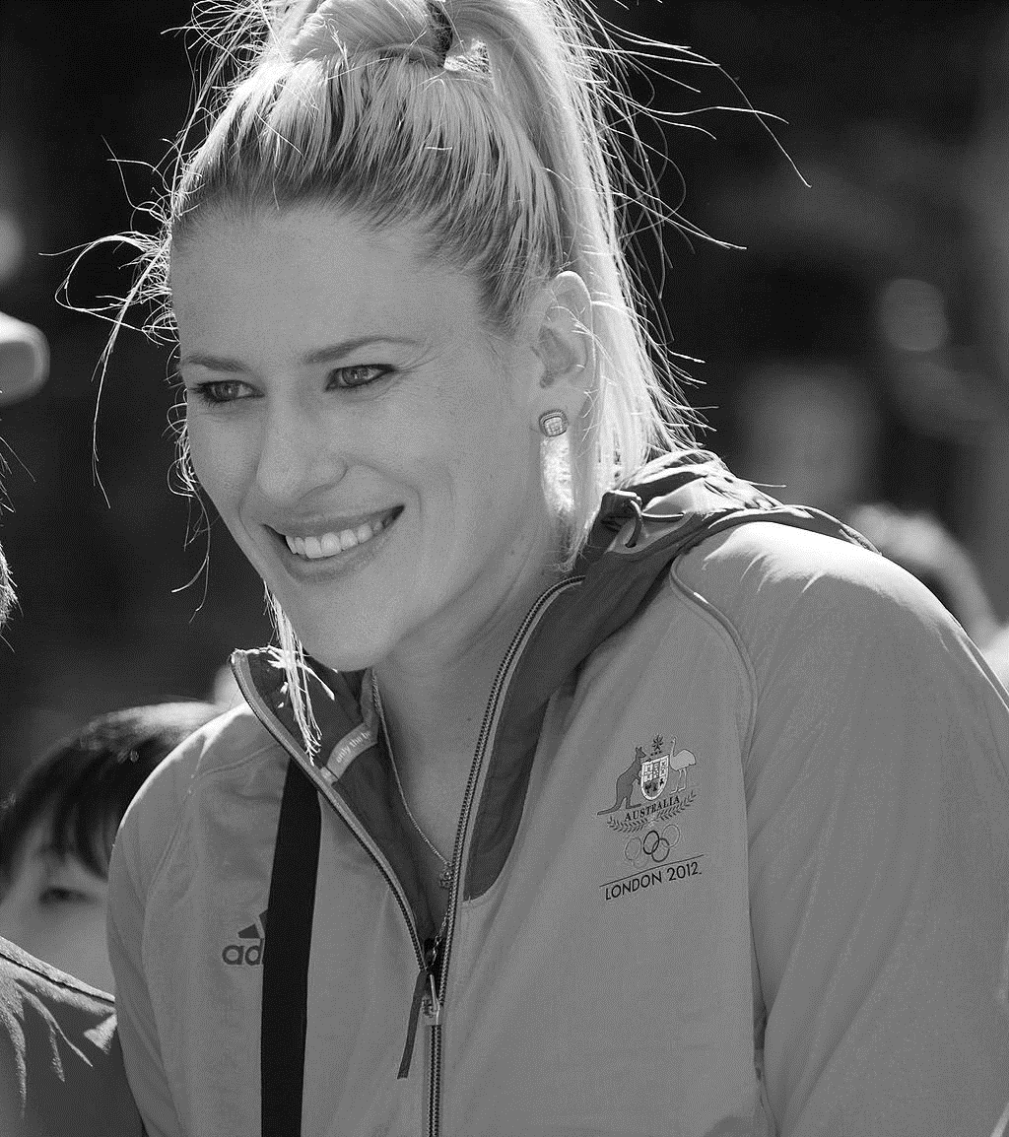
Lauren Jackson
YOUNGEST PLAYER , AGE : 19
Notes:
to become a four-time All-American in college and the 2002 WNBA Rookie of the Year

Slide 34
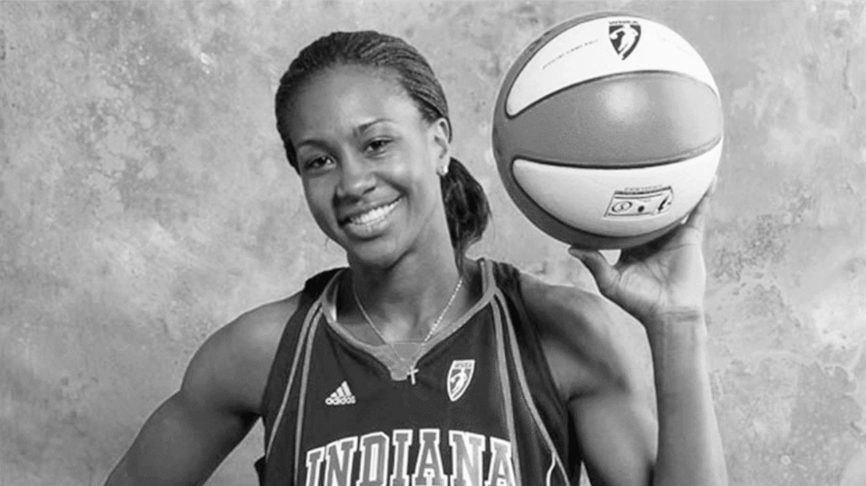
Tamika Catchings
OVERCOME HEARING LOSS
Notes:
to become a four-time All-American in college and the 2002 WNBA Rookie of the Year

Slide 35

Aleix Llopis
FOUND PASSION IN BASKETBALL

Slide 36

Jan Molendijk
FOUND LOVE IN ODD PLACES

Slide 37
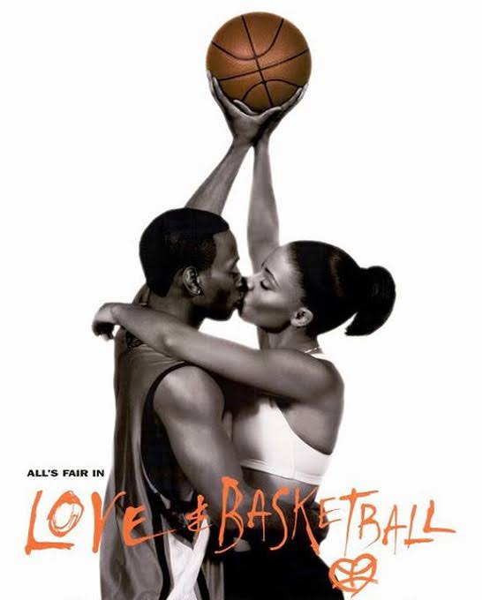

Slide 38
11879
REBOUNDS
8746
DREB
3133
OREB
Notes:
AST:6321
REB: 11879
BLK: 1389
STL: 2517
OREB:3133
DREB: 8746

